Slide 1
UNIT-5

Slide 2
Streaming: Introduction to Stream Processing, Batch processing vs. stream processing, Spark structured streaming API, use case using Spark streaming.
Apache Kafka Fundamentals: Architecture, Brokers, Topics, Partitions, Producers, Consumers, Kafka Connect and Kafka Streams.
Advanced Kafka Features: xactly-Once Semantics, Kafka Transactions, Tiered Storage, Integrating Kafka with Apache Spark and Apache Flink, Integrating Kafka with Spark Streaming, Real-time Analytics Use Cases with Kafka such as Fraud Detection, Clickstream Analysis, Real-time Monitoring.

Slide 3
What is Stream Processing?
Spark Streaming, which focuses on processing data streams in real time.
A data stream is a continuous sequence of records. Common examples include activity stream data from a web or mobile application, time-stamped log data, transactional data, and event streams from sensor or device networks.
The batch processing approach typically involves saving the data stream to an intermediate storage system (for example, HDFS or a database) and running a batch process on the saved data. In order to generate up-to-date results, the batch process must be run periodically (for example, daily, hourly, or even every few minutes) on the latest data available.

Slide 4
An introduction to Spark Streaming
Two of the most common ones are as follows:
Treat each record individually and process it as soon as it is seen.
Combine multiple records into mini-batches. These mini-batches can be delineated either by time or by the number of records in a batch

Slide 5
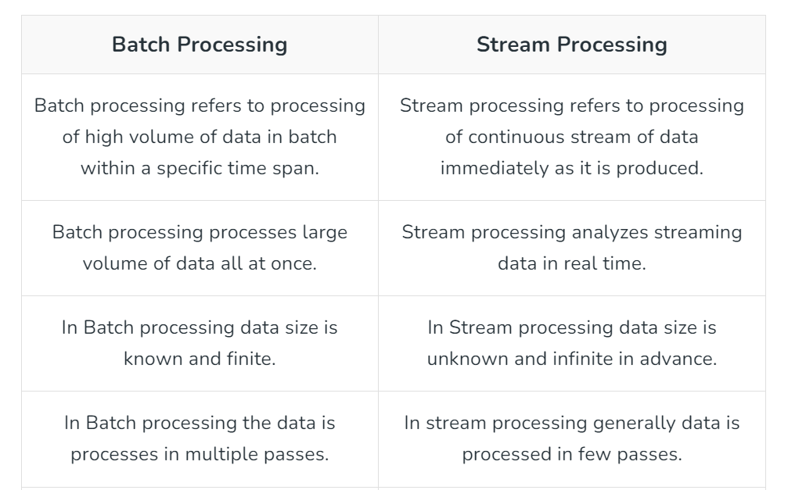

Slide 6
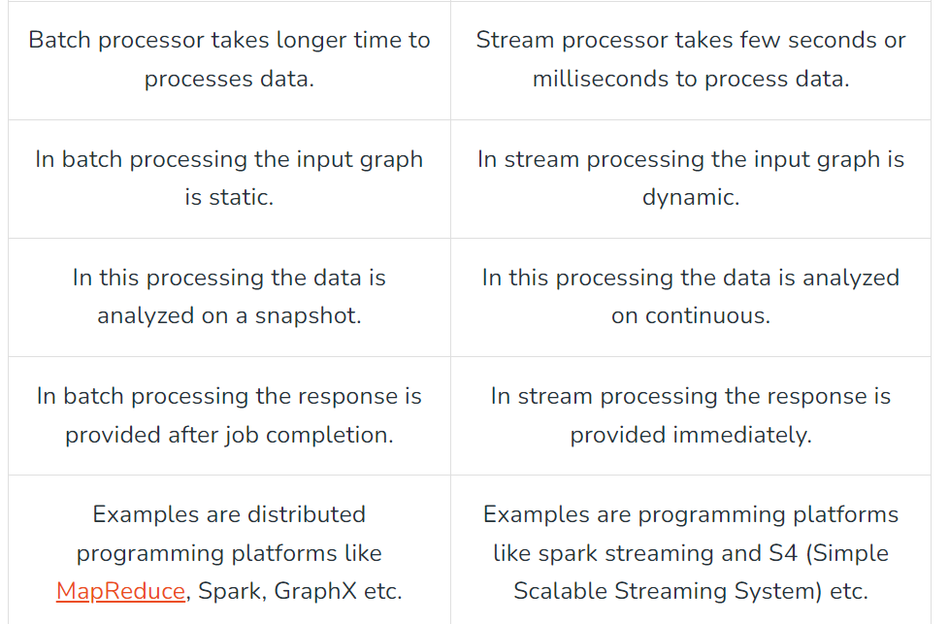

Slide 7
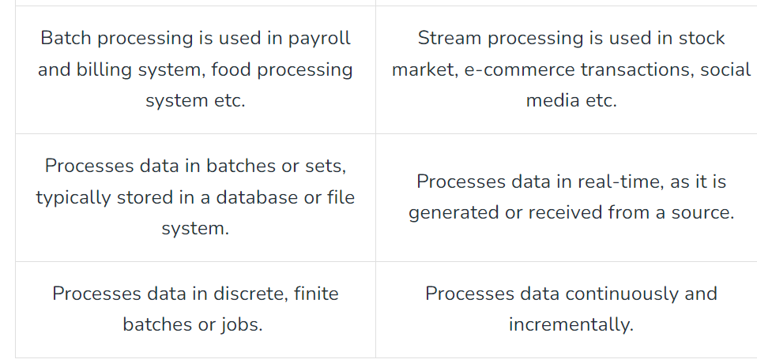

Slide 8
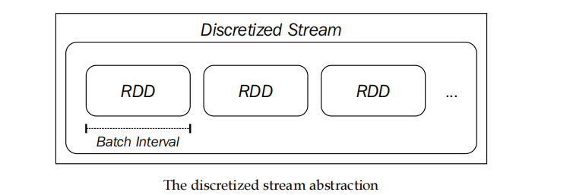
Spark Streaming takes the second approach. The core primitive in Spark Streaming is the discretized stream, or DStream. A DStream is a sequence of mini-batches, where each mini-batch is represented as a Spark RDD:

Slide 9
Input sources
Spark Streaming receivers are responsible for receiving data from an input source and converting the raw data into a DStream made up of Spark RDDs.
Spark Streaming supports various input sources, including file-based sources and network-based sources (such as receivers that communicate with socket-based sources, the Twitter API stream, Akka actors, or message queues and distributed stream and log transfer frameworks, such Flume, Kafka, and Amazon Kinesis)

Slide 10
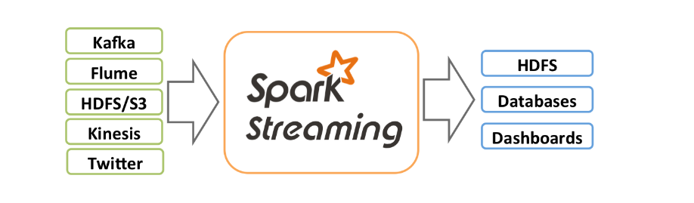
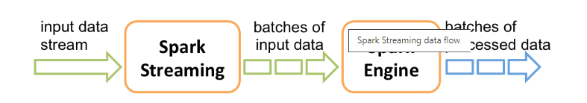

Slide 11
Transformations & Actions
Spark Streaming provides a set of transformations available on DStreams; these transformations are similar to those available on RDDs. These include map, flatMap, filter, join, and reduceByKey.
Spark Streaming has the concept of actions on DStreams. Actions are output operators that, when invoked, trigger computation on the DStream.
Like print, saveAsObjectFile, saveAsTextFiles, and saveAsHadoopFiles, forEachRDD.

Slide 12
Case studies
https://medium.com/@uzzaman.ahmed/introduction-to-spark-streaming-real-time-data-processing-with-ease-bf96e241ed8e

Slide 13
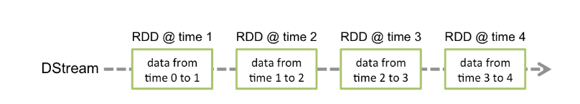
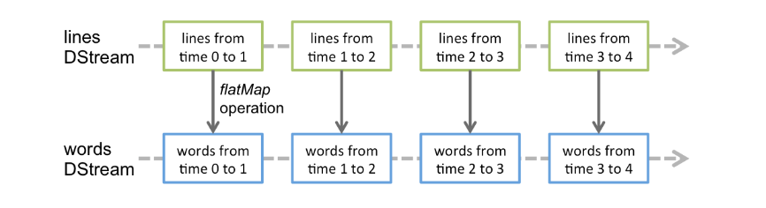

Slide 14
What is kafka?
Apache Kafka is an open-source data streaming platform that allows users to publish, store, process, and subscribe to streams of data in real time.
Kafka combines two messaging models, queuing and publish-subscribe, to provide the benefits of each. Queuing allows data processing to be distributed across many consumer instances, while publish-subscribe can have more than one subscriber. Kafka uses a partitioned log model to combine these two ideas.

Slide 15
Kafka has many use cases, including:
Real-time data pipelines:Kafka can be used to build data pipelines that process and move data from one system to another in real time. For example, you can use Kafka to track how people use a website by ingesting and storing user activity data.
Message broker:Kafka can be used as a message broker to process and mediate communication between two applications.
Centralizing data:Kafka can be used to centralize data from various system components into one place. This can make it a single source of truth.
Kafka was originally created by LinkedIn in 2011 to handle real-time data feeds. It was named after Franz Kafka because the framework is "a system geared for writing".

Slide 16
Kafka provides three main functions to its users:
Publish and subscribe to streams of records
Effectively store streams of records in the order in which records were generated
Process streams of records in real time

Slide 17
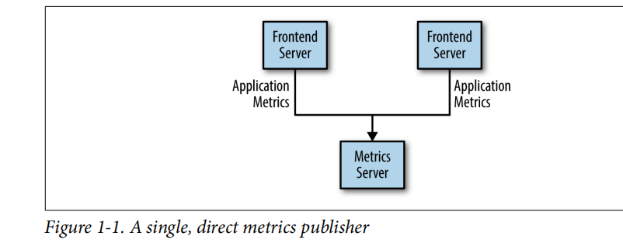
Apache Kafka Fundamentals

Slide 18
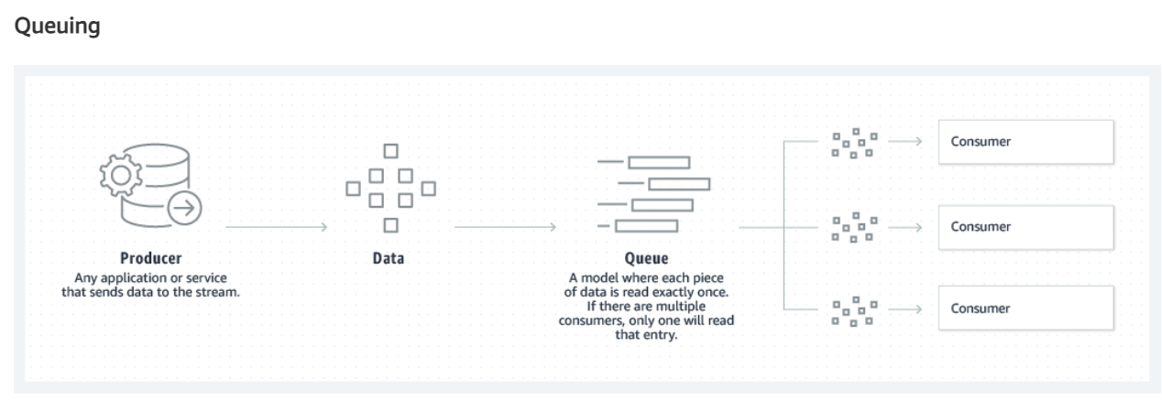

Slide 19
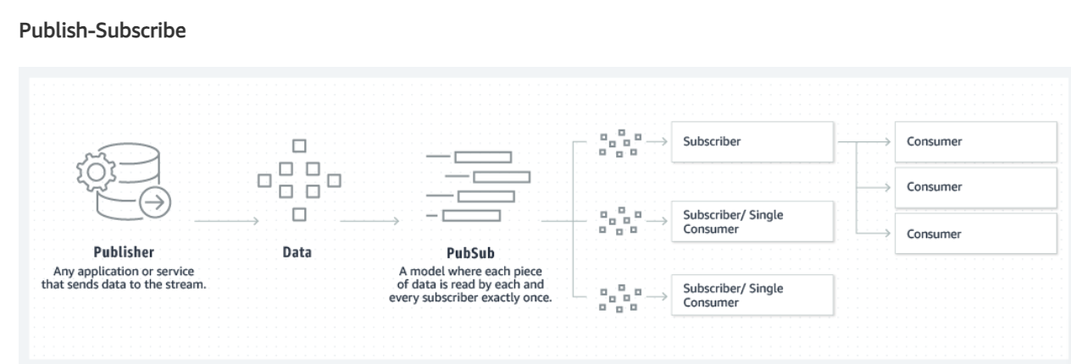

Slide 20
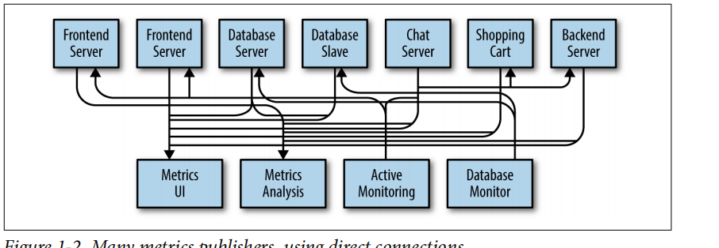
Many metrics publishers, using direct connections

Slide 21
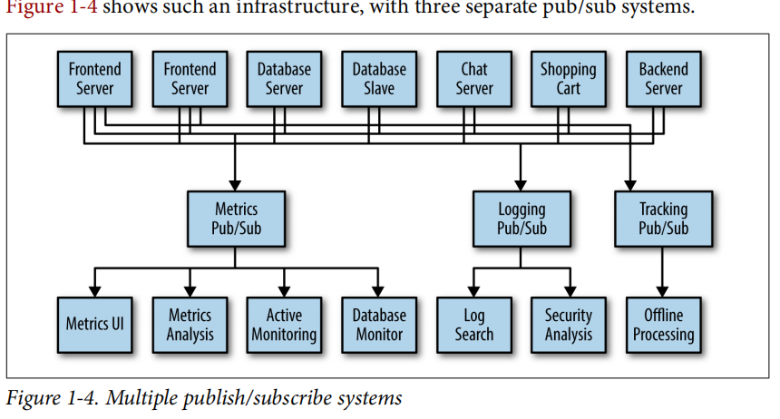

Slide 22
Kafka
A filesystem or database commit log is designed to provide a durable record of all transactions so that they can be replayed to consistently build the state of a system.
Similarly, data within Kafka is stored durably, in order, and can be read deterministically. In addition, the data can be distributed within the system to provide additional protections against failures, as well as significant opportunities for scaling performance.

Slide 23
The unit of data within Kafka is called a message. A message is simply an array of bytes as far as Kafka is concerned, so the data contained within it does not have a specific format or meaning to Kafka. A message can have an optional bit of metadata, which is referred to as a key.
The key is also a byte array and, as with the message, has no specific meaning to Kafka. Keys are used when messages are to be written to partitions in a more controlled manner.
For efficiency, messages are written into Kafka in batches. A batch is just a collection of messages, all of which are being produced to the same topic and partition. An individual roundtrip across the network for each message would result in excessive overhead, and collecting messages together into a batch reduces this.

Slide 24
Schemas, Topics and Partitions
While messages are opaque byte arrays to Kafka itself, it is recommended that additional structure, or schema, be imposed on the message content so that it can be easily understood.
There are many options available for message schema, depending on your application’s individual needs. Simplistic systems, such as Javascript Object Notation (JSON) and Extensible Markup Language (XML), are easy to use and human-readable.
Messages in Kafka are categorized into topics. The closest analogies for a topic are a database table or a folder in a filesystem. Topics are additionally broken down into a number of partitions.

Slide 25
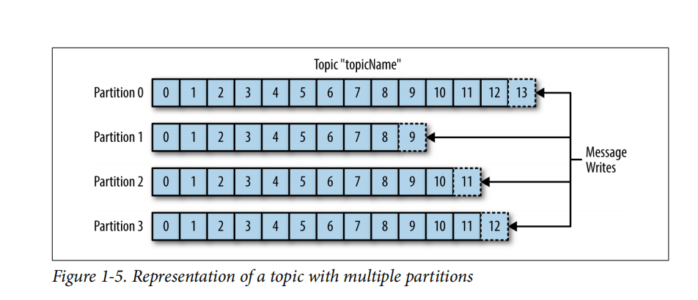
The term stream is often used when discussing data within systems like Kafka. Most often, a stream is considered to be a single topic of data, regardless of the number of partitions.
This represents a single stream of data moving from the producers to the consumers. This way of referring to messages is most common when discussing stream processing, which is when frameworks—some of which are Kafka Streams, Apache Samza, and Storm—operate on the messages in real time.
This method of operation can be compared to the way offline frameworks, namely Hadoop, are designed to work on bulk data at a later time

Slide 26
Producers and Consumers
Kafka clients are users of the system, and there are two basic types: producers and consumers. There are also advanced client APIs—Kafka Connect API for data integration and Kafka Streams for stream processing. The advanced clients use producers and consumers as building blocks and provide higher-level functionality on top.
Producers create new messages. In other publish/subscribe systems, these may be called publishers or writers. In general, a message will be produced to a specific topic.
By default, the producer does not care what partition a specific message is written to and will balance messages over all partitions of a topic evenly

Slide 27
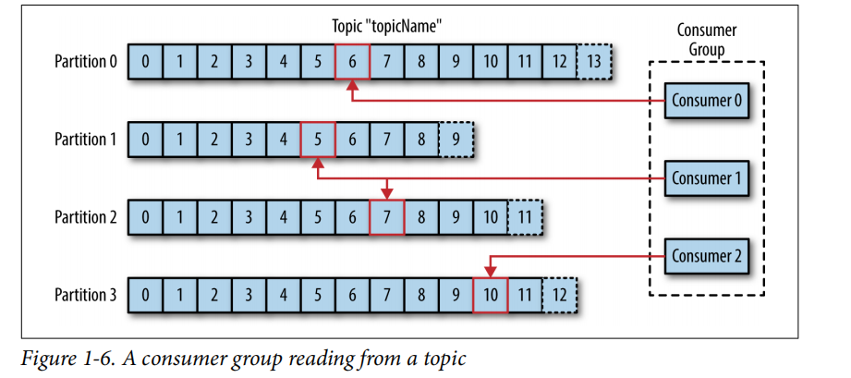
Consumers read messages. In other publish/subscribe systems, these clients may be called subscribers or readers. The consumer subscribes to one or more topics and reads the messages in the order in which they were produced.

Slide 28
Brokers and Clusters
A single Kafka server is called a broker. The broker receives messages from producers, assigns offsets to them, and commits the messages to storage on disk.
It also servicesconsumers, responding to fetch requests for partitions and responding with the messages that have been committed to disk. Depending on the specific hardware and its performance characteristics, a single broker can easily handle thousands of partitions and millions of messages per second.
Kafka brokers are designed to operate as part of a cluster. Within a cluster of brokers,one broker will also function as the cluster controller (elected automatically from the live members of the cluster).

Slide 29
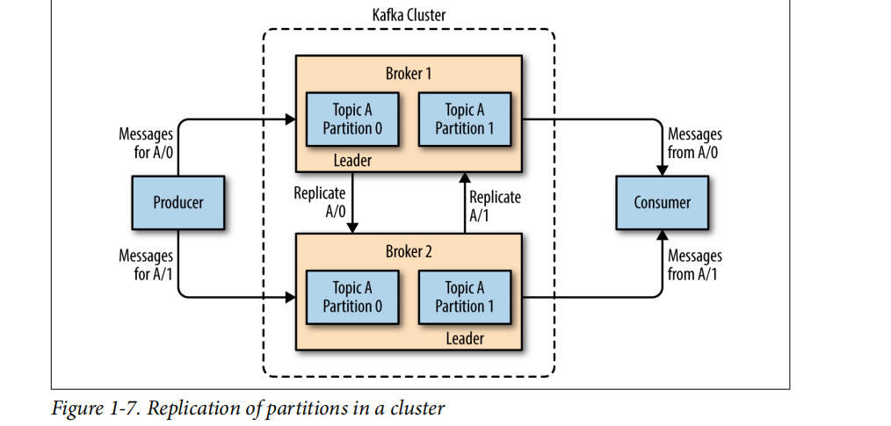

Slide 30
Why Kafka?
Multiple Producers
Multiple Consumers
Disk-Based Retention
Scalable
High Performence

Slide 31
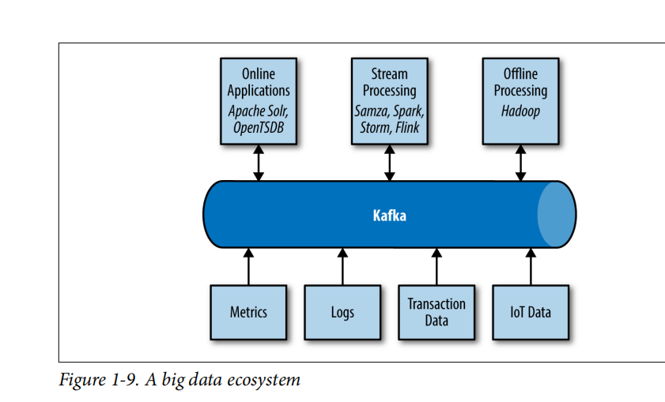
ECO SYSTEM

Slide 32
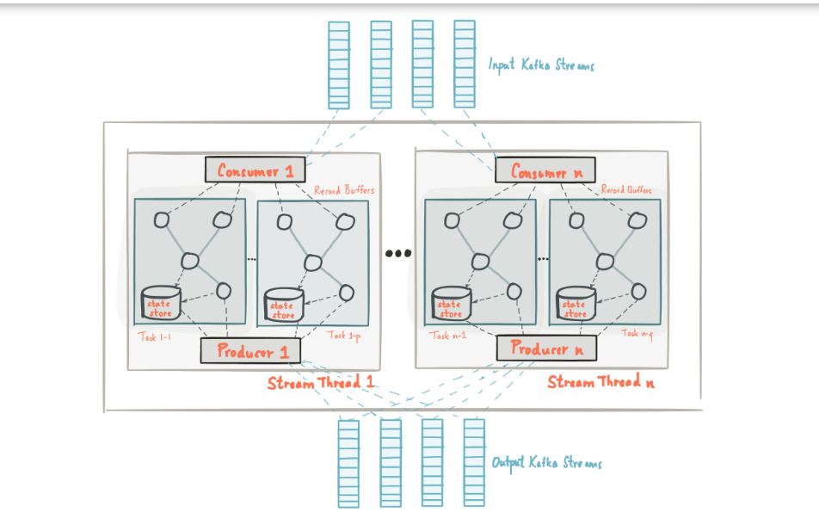
https://kafka.apache.org/11/documentation/streams/architecture

Slide 33
How does Kafka's architecture integrate different models?
Kafka remedies the two different models by publishing records to different topics. Each topic has a partitioned log, which is a structured commit log that keeps track of all records in order and appends new ones in real time.
These partitions are distributed and replicated across multiple servers, allowing for high scalability, fault-tolerance, and parallelism. Each consumer is assigned a partition in the topic, which allows for multi-subscribers while maintaining the order of the data.
By combining these messaging models, Kafka offers the benefits of both. Kafka also acts as a very scalable and fault-tolerant storage system by writing and replicating all data to disk. By default, Kafka keeps data stored on disk until it runs out of space, but the user can also set a retention limit.

Slide 34
Apache Kafka
Apache Kafka is an open-source distributed event streaming platform used by thousands of companies for high-performance data pipelines, streaming analytics, data integration, and mission-critical applications.
Publish/Subscribe
Fire-Forget
Push-Pull

Slide 35
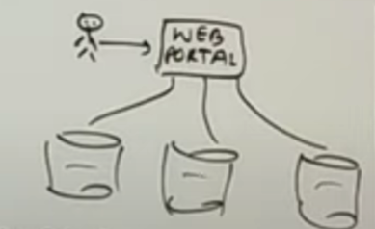
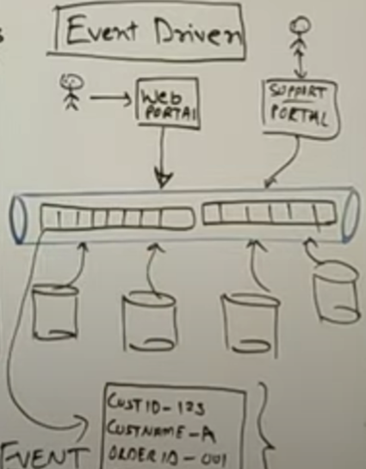
EVENT BASED
Web Portal data driven
Event Based

Slide 36
Key Concepts of Kafka
Log Commit
Message : Smallest Unit in Kafka (buy a item)
Topic eg: Customer may have multple partitions
Partition -view(events can be sequenced in the same applicationonly )
kafka cluster
kafka broker

Slide 37
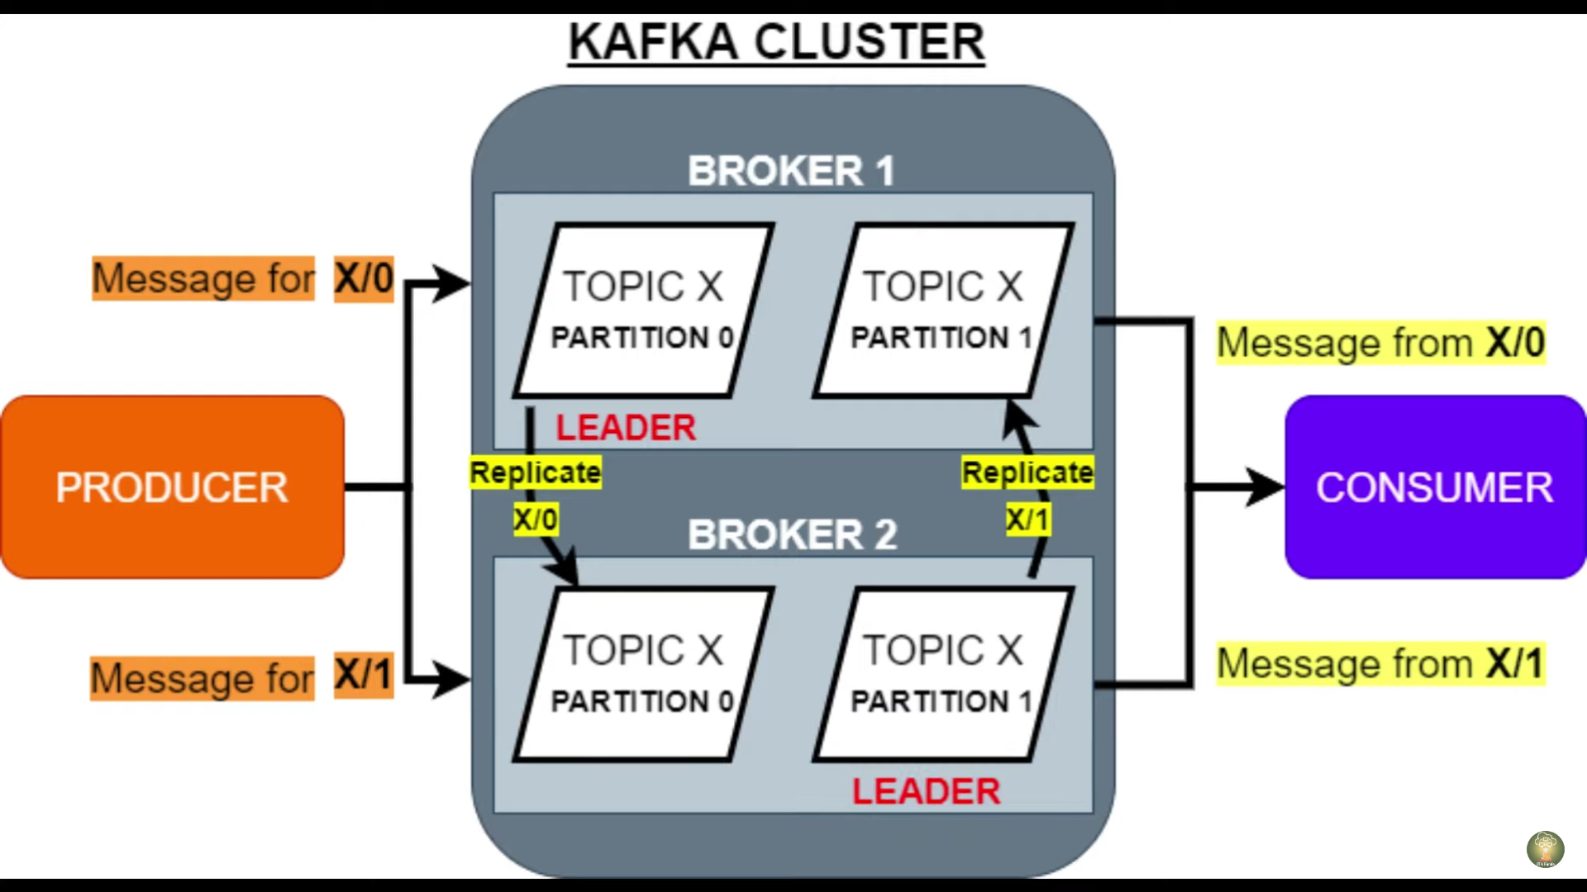

Slide 38
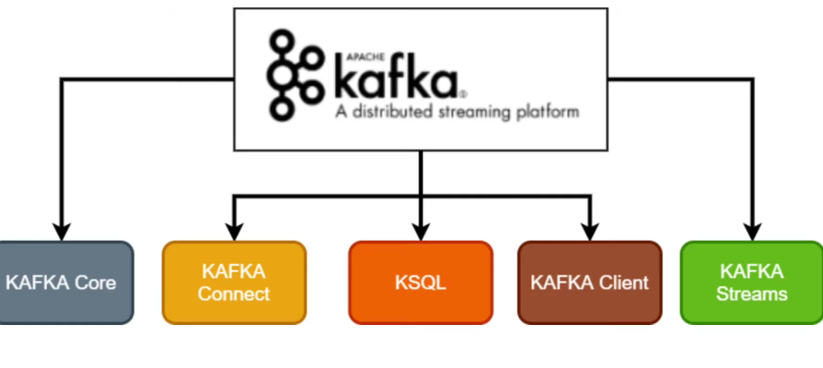

Slide 39
Semantics
Exactly Once
Atleast Once
Atmost Once

Slide 40
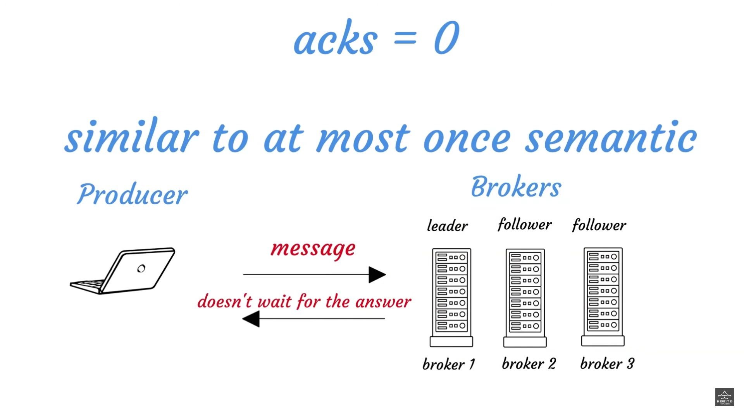

Slide 41
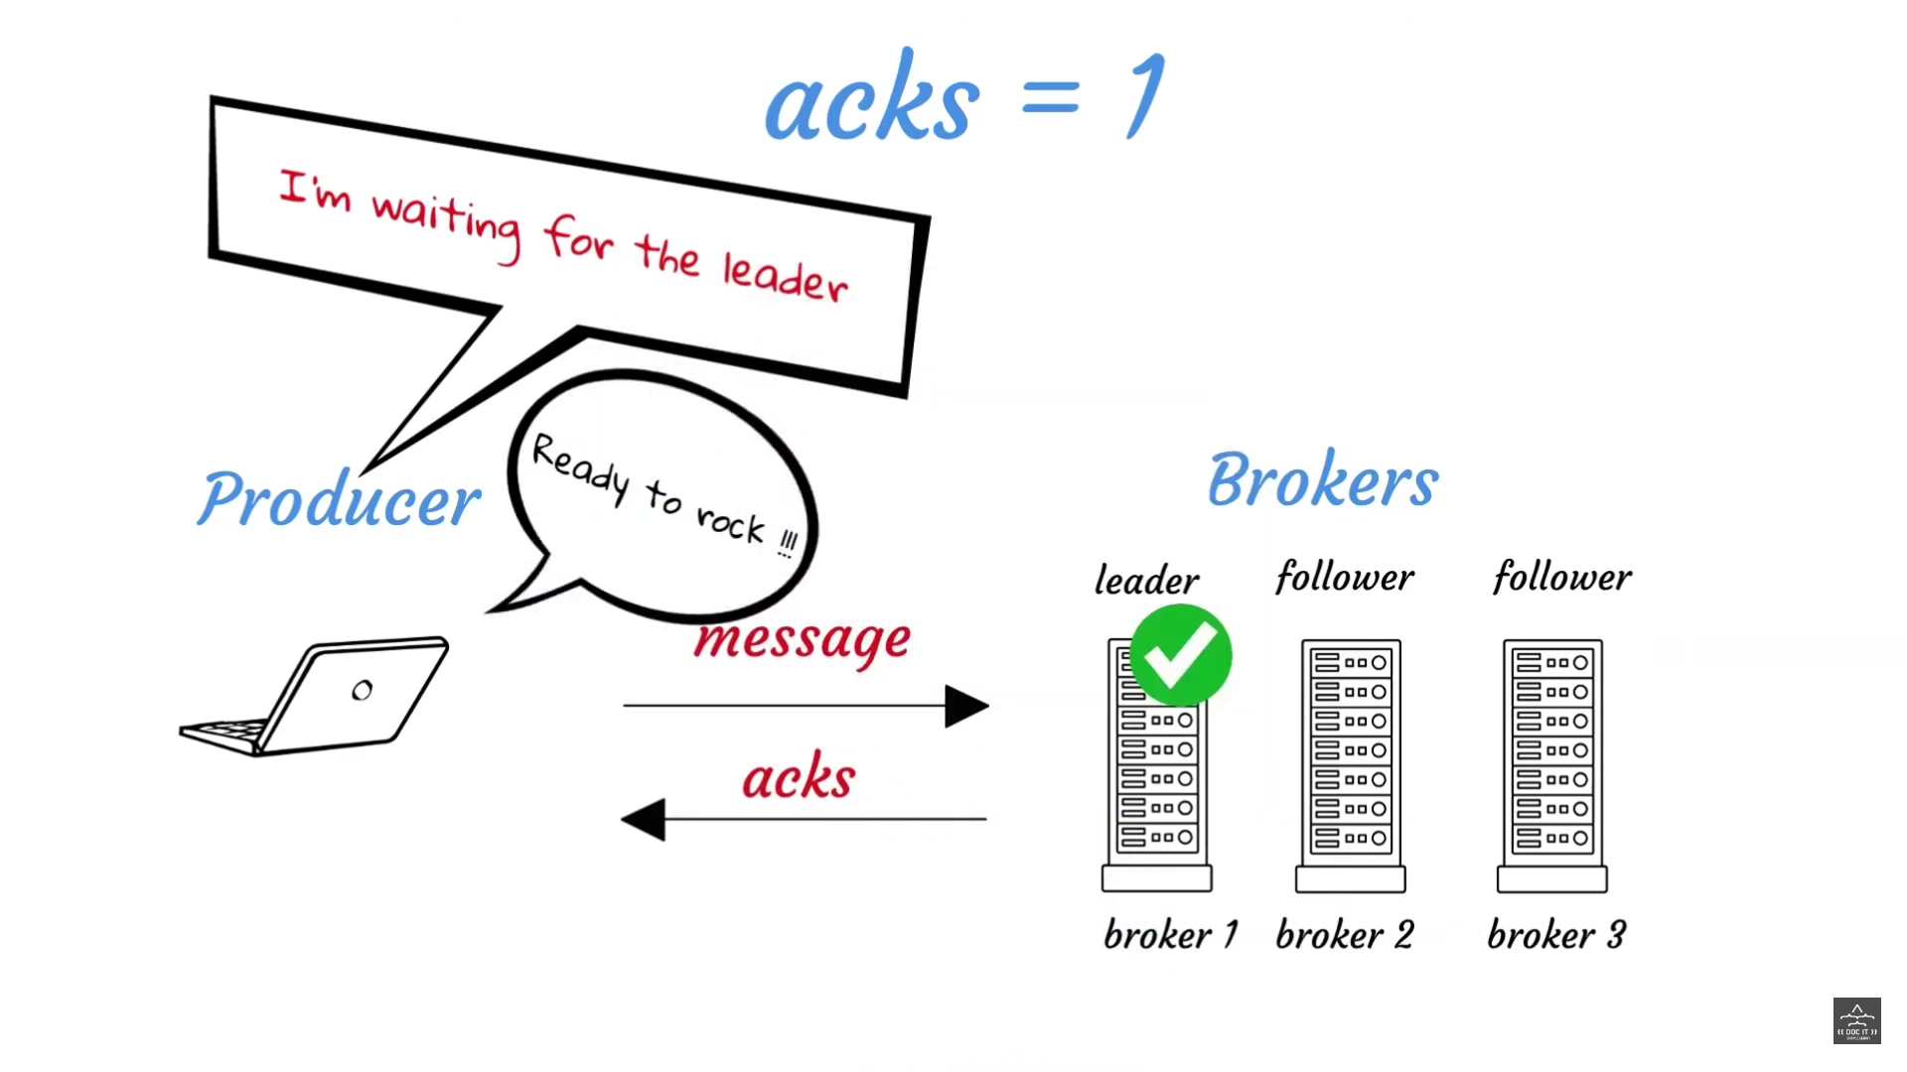

Slide 42
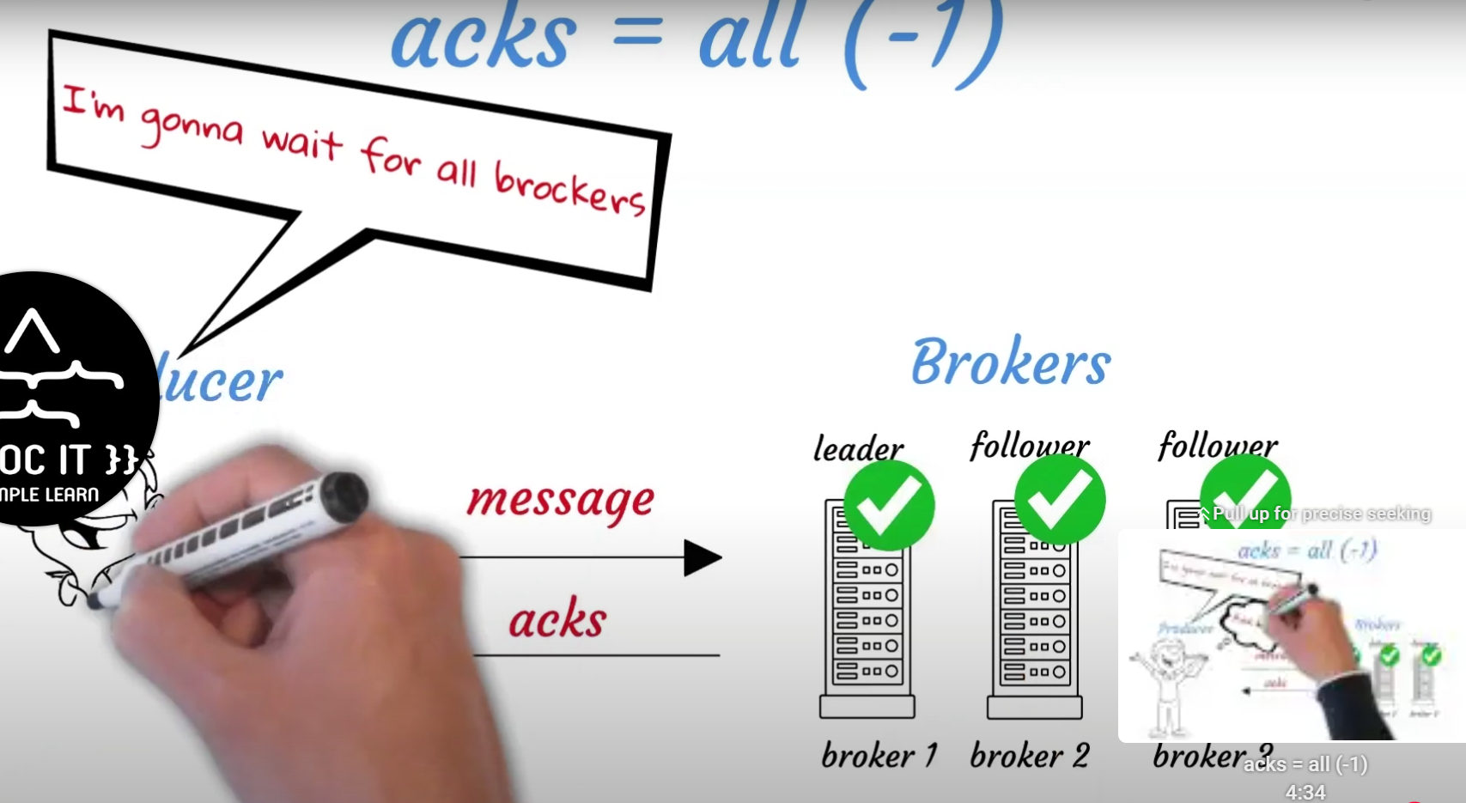
Producer
Verifying from all the Brokers

Slide 43
Exactly-Once Semantics (EOS)
Exactly-once semantics (EOS) is a delivery guarantee in Kafka that ensures messages are delivered to consumers exactly once, even if failures or retries occur.
Use Cases: Ideal for applications where data accuracy and reliability are crucial, such as financial transactions, stock trading, and other critical applications.
Implementation:
Kafka uses unique IDs for messages, allowing it to detect duplicates.
EOS requires enabling idempotence in the Kafka producer to prevent duplicate message writes on retries.
Consumers can achieve EOS by committing offsets only after a transaction completes, ensuring messages are processed exactly once.

Slide 44
Kafka Transactions
Purpose: Kafka Transactions ensure that a set of messages is either fully written or fully discarded, guaranteeing atomicity in data processing workflows.
Key Components:
Producer: Sends messages within a transaction by calling the initTransactions() and beginTransaction() methods.
Consumer: Processes a batch of messages and only commits the offset when a transaction completes, ensuring messages are processed only once.
Transactional APIs:
Kafka provides APIs like beginTransaction, commitTransaction, and abortTransaction.
A producer can publish multiple messages to multiple partitions in one atomic transaction.
Benefits:
Useful in ensuring data consistency across Kafka topics and downstream systems.
Allows creating a single processing unit across multiple topics, ensuring data accuracy and consistency.
Limitations:
Transactional processing is more resource-intensive and can add latency.

Slide 45
Tiered Storage
Definition: Tiered storage in Kafka allows for the segregation of data across different storage tiers, optimizing for cost and performance.
Motivation: Kafka stores data in brokers, which may become costly as data grows. Tiered storage allows old data to move to cheaper storage tiers (e.g., cloud storage), keeping only recent data on more expensive, faster storage.
Key Benefits:
Cost Savings: Moves older, less frequently accessed data to cheaper storage.
Scalability: Kafka can manage longer data retention periods without excessive storage costs.
Enhanced Performance: Reduces load on primary storage, improving performance for recent data access.

Slide 46
How it Works:
Kafka uses policies to automatically transition data between hot (frequently accessed) and cold (infrequently accessed) storage.
Popular implementations include S3 and other cloud-based storage solutions for older data.

Slide 47
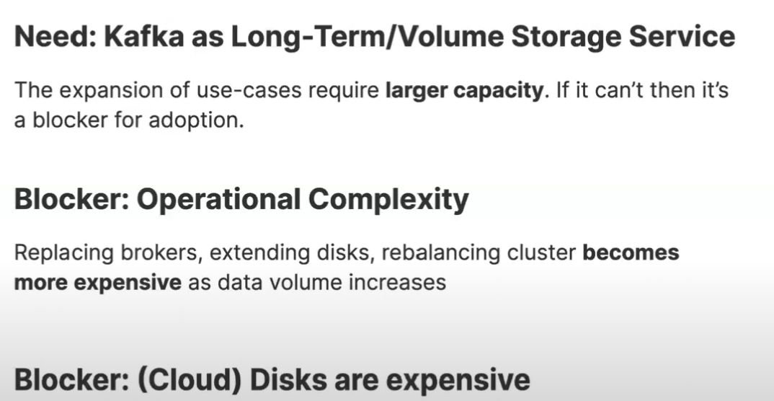
Storage
File System -for storage

Slide 48
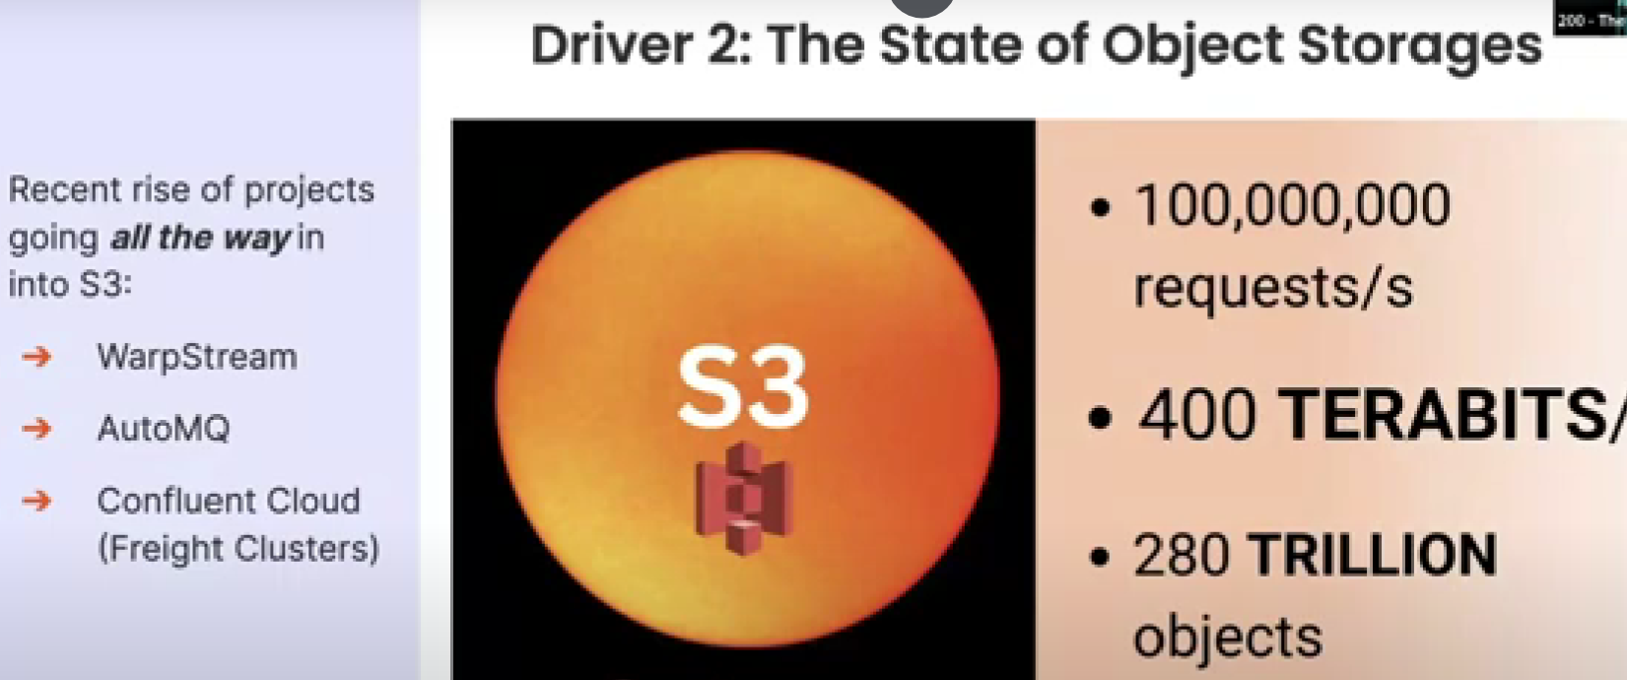

Slide 49
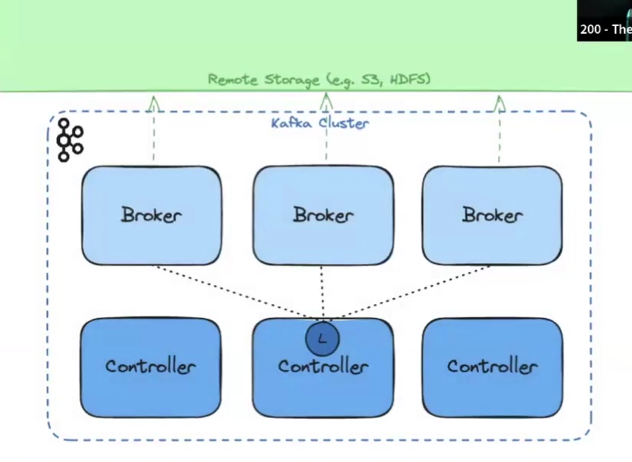
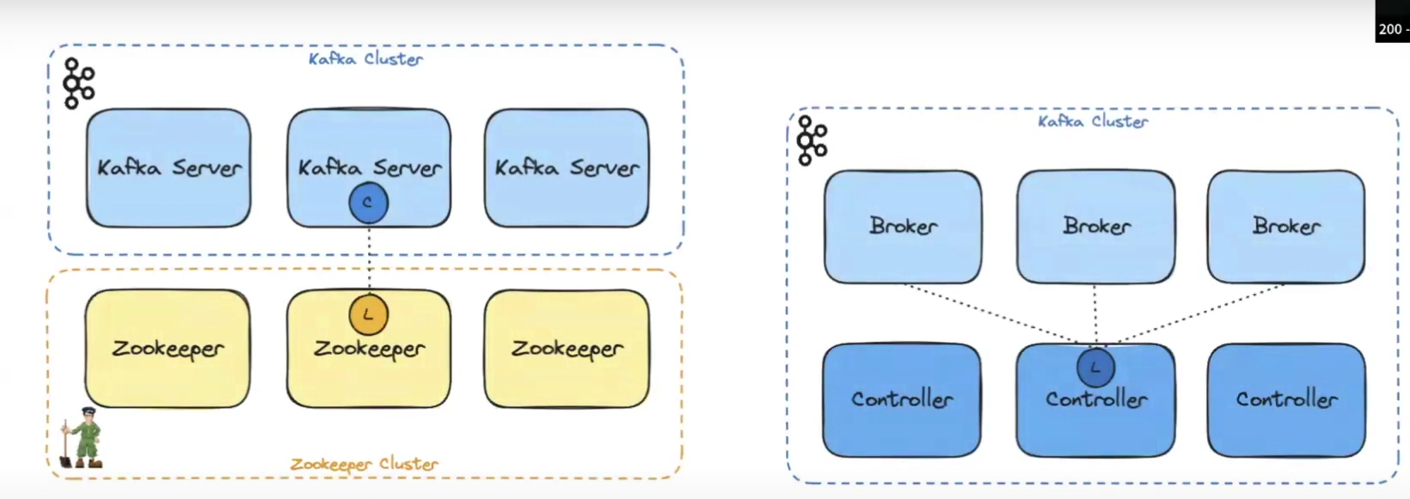

Slide 50
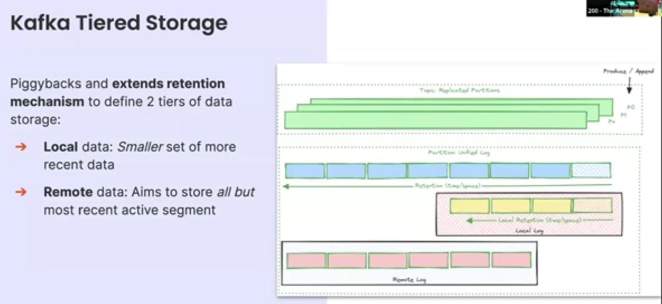
Kafka Tierd Architecture

Slide 51
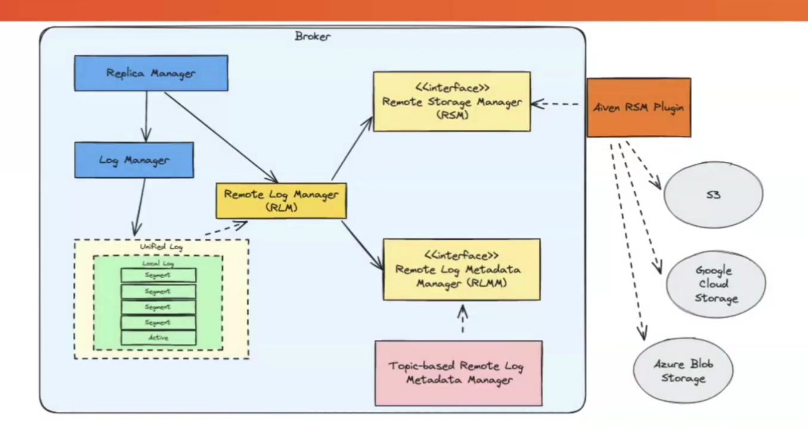

Slide 52
Integrating Kafka with Apache Spark and Apache Flink
Spark provides libraries like KafkaUtils to easily consume Kafka topics.
Structured Streaming: Spark’s Structured Streaming API supports streaming from Kafka with ease and provides exactly-once processing.
Benefits of Integration:
Spark can perform complex, high-throughput data analytics and transformations on Kafka streams.
Spark’s DataFrames allow powerful, SQL-like operations on streaming data.

Slide 53
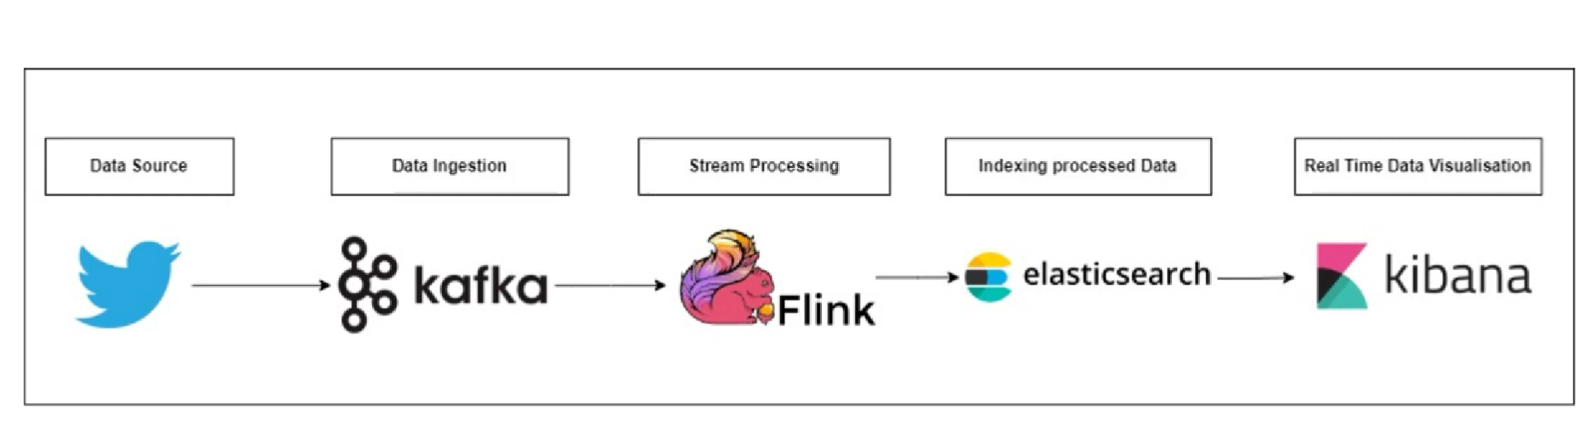

Slide 54
Example Workflow:
Ingest data from Kafka -> Process and analyze with Spark’s transformations -> Output data back to Kafka or another storage layer.
Fault Tolerance: Spark’s checkpointing mechanism ensures reliable recovery in case of failures.

Slide 55
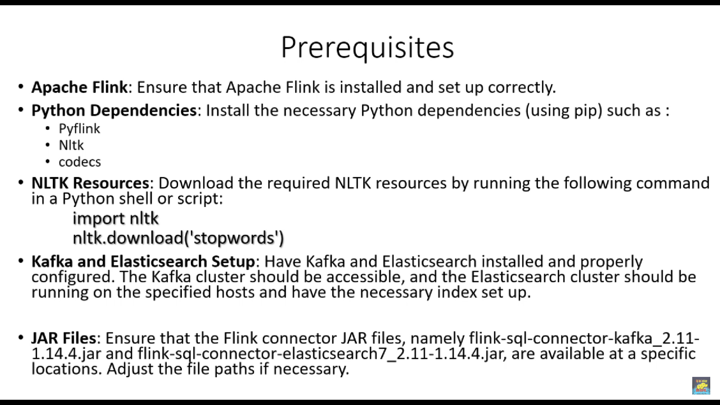
Case Study Example : https://youtu.be/ZP29tSlKJ3A?si=jOaflsd2YPE0qrjJ

Slide 56
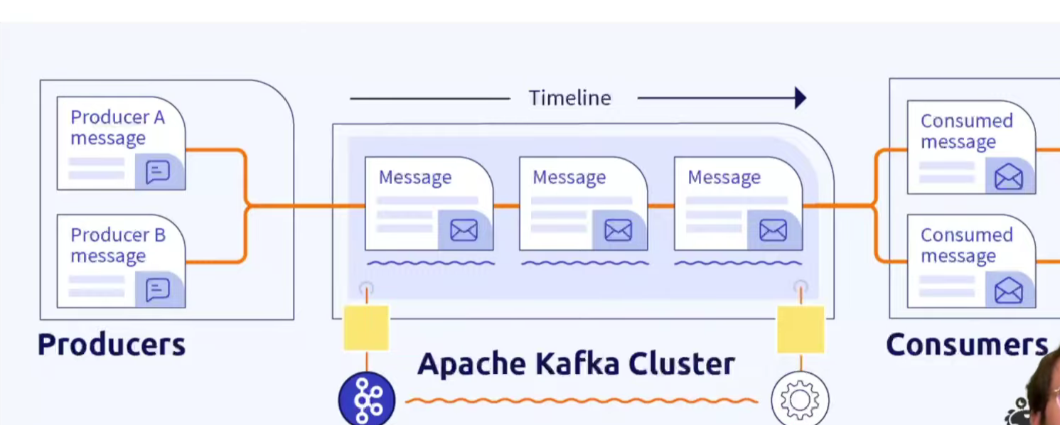
Apache Streaming

Slide 57
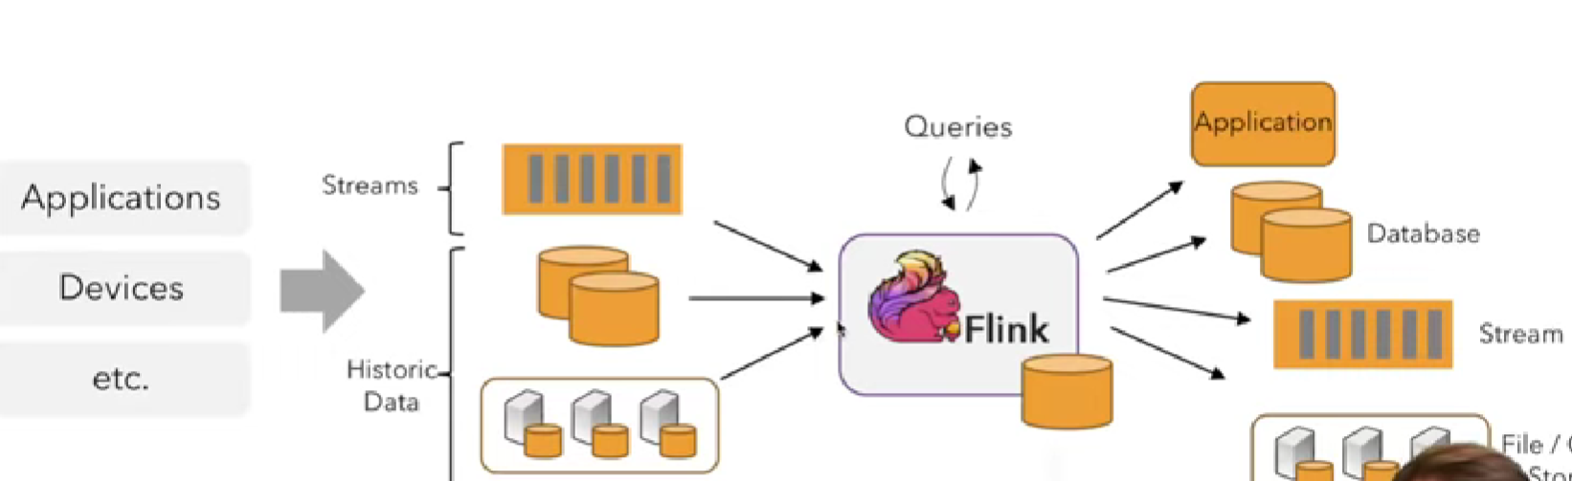
Apahe Flink
Data bases

Slide 58
Apache Flink
Apache Flink provides native connectors for Kafka, allowing real-time data processing and analytics.
Features:
Flink’s Kafka connector supports both at-least-once and exactly-once semantics, making it ideal for stateful streaming applications.
Flink’s state management allows efficient handling of streaming states, providing robust fault tolerance.
Benefits of Integration:
High-performance, low-latency data processing.
Ability to handle complex event-driven use cases in near-real-time.

Slide 59
Integrating Kafka with Spark Streaming
Spark Streaming with Kafka enables scalable, real-time processing of Kafka data streams.
Integration:
Spark Streaming can connect to Kafka using the KafkaUtils.createDirectStream() method.
This approach allows Spark to fetch data directly from Kafka, achieving exactly-once semantics if needed.
Advantages:
Real-time processing: Spark Streaming processes each Kafka batch in near real-time.
Fault tolerance: Achieved through Spark’s checkpointing, ensuring data processing continues in case of failure.
Common Use Cases:
Real-time data pipelines, log analysis, and event-driven architectures.
For example, data is read from Kafka, transformed with Spark Streaming, and written to databases or visualization tools for immediate insights.

Slide 60
Fraud Detection
Fraud detection is a critical application in industries like banking, e-commerce, and telecommunications, where companies must detect and prevent fraudulent activities (e.g., unauthorized transactions, account takeovers) in real time.
How Kafka Helps:
Kafka ingests high-velocity data from multiple sources, such as transaction systems, user logs, and external threat feeds, with minimal latency.
Kafka’s real-time processing capabilities enable early detection of suspicious activities, reducing fraud risks.

Slide 61
Components:
Data Sources: Kafka consumes data from payment gateways, user activity logs, and account access patterns.
Real-time Processing: With tools like Apache Flink or Apache Spark, Kafka streams can be analyzed to detect anomalies.
Anomaly Detection Models: Machine learning models can be integrated with Kafka to score transactions in real time, flagging high-risk ones.
Benefits:
Real-time processing minimizes response time, crucial for preventing fraud.
Scalable to handle fluctuating transaction volumes, such as those during sales or holidays.
Example:
When a high-value transaction is flagged as unusual, Kafka triggers alerts for further investigation or automatically blocks the transaction if it surpasses a risk threshold.

Slide 62
Clickstream Analysis
Overview: Clickstream analysis is widely used in e-commerce, advertising, and media to understand user behavior, improve customer experience, and optimize marketing campaigns.
How Kafka Helps:
Kafka collects and processes clickstream data in real time, including clicks, page views, and other actions, as users interact with a website or app.
The high throughput of Kafka allows for large volumes of user interaction data to be analyzed in real time.
Components:
Data Collection: Clickstream data, such as user clicks, page transitions, and time spent on each page, is streamed to Kafka.
Real-time Processing: Clickstream data is enriched, filtered, and transformed with Kafka Streams or external processing tools like Spark Streaming.
Analytics: Using Kafka with analytics tools enables user segmentation, recommendation systems, and campaign performance tracking.

Slide 63
Benefits:
Provides immediate insights into user behavior, enabling personalized recommendations and targeted advertising.
Scalable to handle millions of events per second, accommodating spikes in user activity.
Example:
An e-commerce website captures clicks in real time to recommend products based on user interactions, enabling personalized shopping experiences and driving conversions.

Slide 64
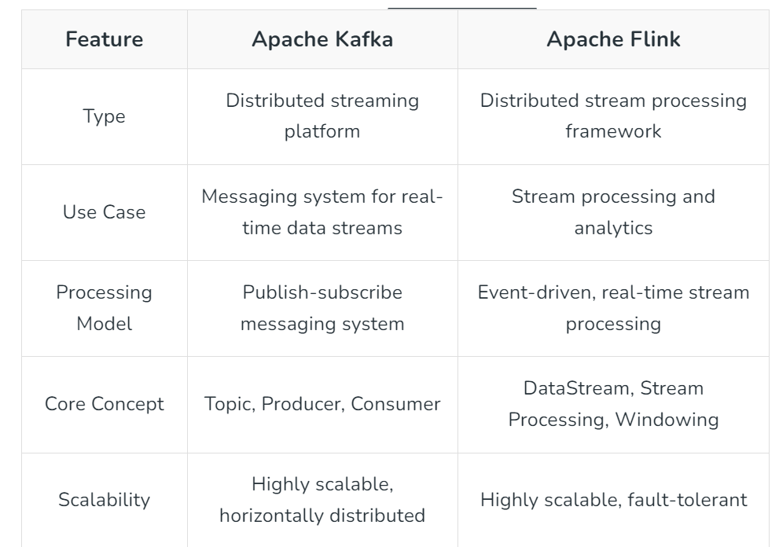

Slide 65
Real-time Monitoring
Overview: Real-time monitoring is essential for infrastructure management, IT operations, and application performance monitoring, where immediate detection of issues is critical.
How Kafka Helps:
Kafka aggregates logs, metrics, and other monitoring data from servers, applications, and network devices, allowing teams to identify and resolve issues faster.
It can process and forward metrics to dashboards and alerting systems with minimal delay.

Slide 66
Components:
Data Sources: Kafka collects data from various sources, such as application logs, network devices, and hardware metrics.
Processing and Aggregation: Kafka Streams or external processing engines process and aggregate data to identify trends, patterns, and anomalies.
Dashboards and Alerts: Integration with monitoring tools (e.g., Grafana, Prometheus) allows for visualizing metrics in real time and sending alerts based on pre-defined thresholds.
Benefits:
Continuous, real-time monitoring allows quick responses to issues before they escalate, reducing downtime and ensuring system reliability.
Can handle vast volumes of telemetry data generated by complex infrastructures.

Slide 67
Example:
A microservices-based application uses Kafka to aggregate logs and metrics across services, sending alerts if error rates or response times exceed acceptable thresholds, enabling fast incident resolution.

